Slide 1
PYTHON ACTIVITY 1
CASE STUDIES 81-90
81.Campus Event Selecting and Entry Validation
82.Multi-Criteria Internship Candidate Ranking
83.Food Supply Chain Stock Reconciliation
84.Environmental Monitoring Data Analyzer
85.Smart Classroom Timetable Allocation
86. Multi-Stage ATM Transaction Audit
87.Examination Question Difficulty and Performance analysis
88.multi-Branch Retail Inventory Transfer
89.University Hostel Room Allocation
90.Integrated Campus Energy and Water Audit

Slide 2
Caes-81:Campus Event Seating and Entry Validation
* Problem Statement
Campus events require an efficient system to assign seats, validate tickets, detect duplicate entries, and calculate available seating capacity.
The objective of this case study is to develop a Python program that uses nested lists to generate seating assignments, validates ticket IDs against registered IDs, identifies invalid and duplicate entries, and displays the remaining seating capacity.

Slide 3
Objectives
Generate seating assignments using nested lists.
Validate ticket IDs against registration identifiers.
Detect duplicate ticket entries.
Identify invalid or unregistered tickets.
Calculate total seating capacity.
Display assigned seats and available seats.
Apply Python concepts to solve a real-world problem

Slide 4
Assumptions
Each inner list represents a row of seats.
Each seat has a unique seat label.
Each registered attendee has a unique registration ID.
A ticket is valid if its ID exists in the registered-ID list.
Repeated scans of a valid ticket are treated as duplicate entries.
Attendees are assigned seats in the order of the registration list.
Available seats are calculated by subtracting assigned seats from total seating capacity.

Slide 5
Algorithms
Start the program.
Create nested seating lists, registered IDs, and ticket IDs.
Calculate the total number of seats.
Traverse the nested seating lists and assign seats to attendees.
Read each ticket ID.
Check whether the ticket ID exists in the registered-ID list.
If the ID is not registered, mark the ticket as invalid.
If the ticket has already been scanned, report a duplicate entry.
Otherwise, record the entry as valid.
Calculate the available seating capacity.
Display seating assignments, valid entries, invalid tickets, duplicate entries, and available seats.
Stop the program.

Slide 6
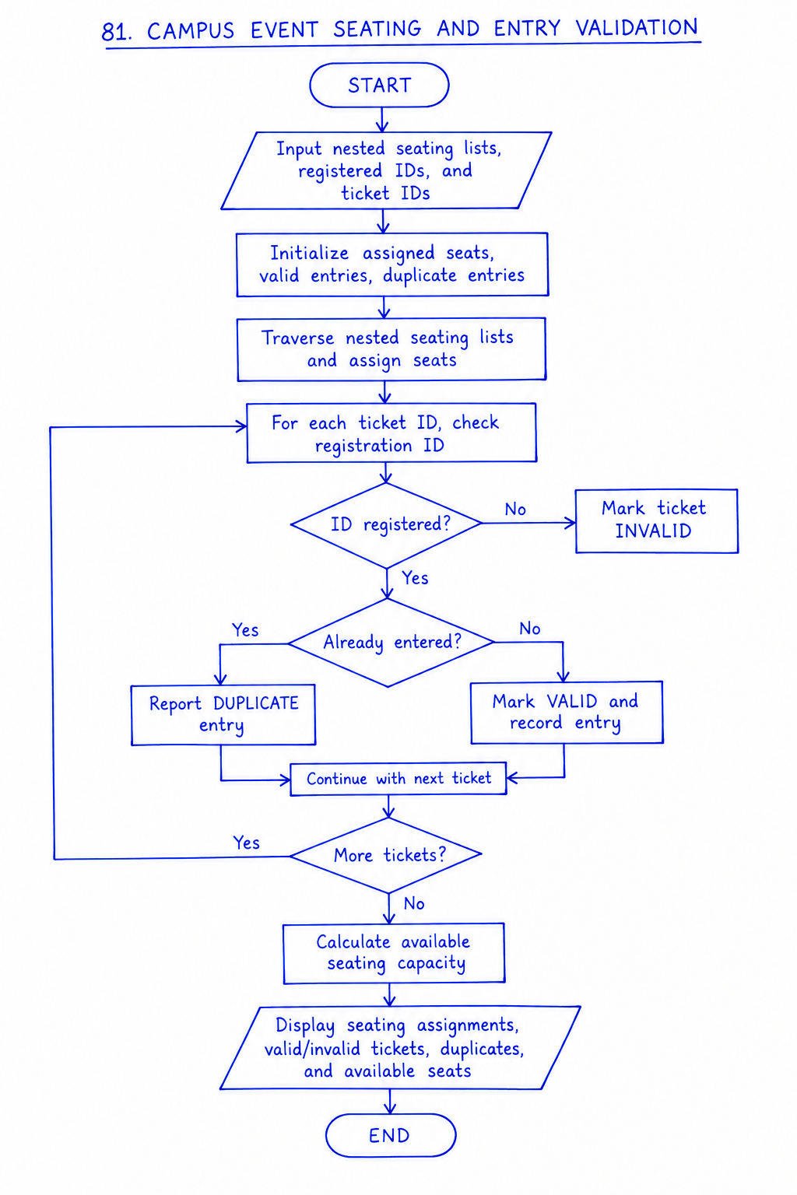
Flow Chart

Slide 7
Python Source Code
def assign_seats(seating_rows, attendees):
assignments = {}
index = 0
for row_number, row in enumerate(
seating_rows, start=1
):
for seat in row:
if index < len(attendees):
assignments[attendees[index]] = (
f"Row {row_number}, Seat {seat}"
)
index += 1
return assignments
def validate_entries(registered_ids, ticket_ids):
registered = set(registered_ids)
seen = set()
valid = []
invalid = []
duplicates = []
for ticket in ticket_ids:
if ticket not in registered:
invalid.append(ticket)
elif ticket in seen:
duplicates.append(ticket)
else:
valid.append(ticket)
seen.add(ticket)
return valid, invalid, duplicates
def main():
seating_rows = [
["A1", "A2", "A3", "A4"],
["B1", "B2", "B3", "B4"],
["C1", "C2", "C3", "C4"]
]
registered_ids = [
"REG101", "REG102", "REG103",
"REG104", "REG105"
]
ticket_ids = [
"REG101", "REG102", "REG101",
"REG999", "REG104"
]
assignments = assign_seats(
seating_rows, registered_ids
)
valid, invalid, duplicates = validate_entries(
registered_ids, ticket_ids
)
total_seats = sum(
len(row) for row in seating_rows
)
assigned_seats = len(assignments)
print("CAMPUS EVENT SEATING AND ENTRY VALIDATION")
print("\\nSEATING ASSIGNMENTS")
for attendee, seat in assignments.items():
print(f"{attendee}: {seat}")
print("\\nENTRY VALIDATION")
print("Valid entries:", valid)
print("Invalid tickets:", invalid)
print("Duplicate entries:", duplicates)
print("\\nSEATING CAPACITY")
print("Total seats:", total_seats)
print("Assigned seats:", assigned_seats)
print("Available seats:",
total_seats - assigned_seats)
if __name__ == "__main__":
main()

Slide 8
Test Cases
Test Case | Input | Expected Result
1 | REG101 | Valid ticket
2 | REG999 | Invalid ticket
3 | REG101 scanned twice | Duplicate entry detected
4 | 12 seats and 5 attendees | 7 seats available
5 | Registered attendees with available seats | Seats assigned in order
Test Cases

Slide 9
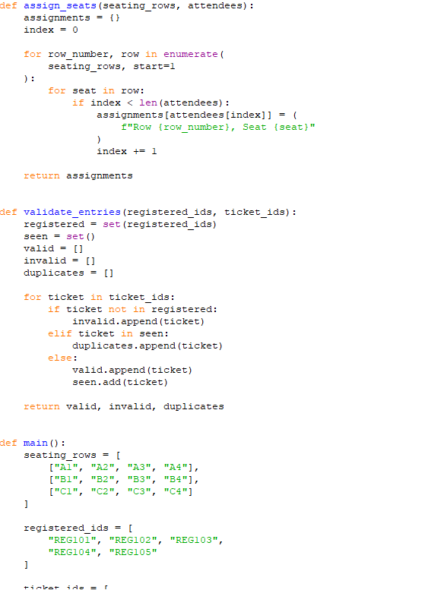
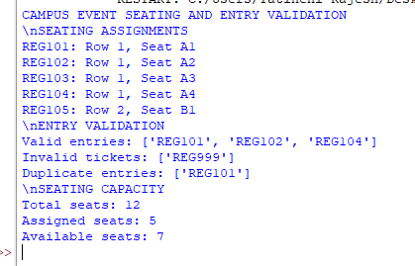
Code And Output
CODE
OUTPUT

Slide 10
Conclusion
The Campus Event Seating and Entry Validation program demonstrates how Python can be used to manage seating arrangements and ticket validation efficiently.
Using nested lists, sets, loops, functions, and conditional statements, the program assigns seats, validates registration IDs, detects duplicate entries, identifies invalid tickets, and calculates available seating capacity.
This case study demonstrates the practical application of Python programming concepts to campus event management.

Slide 11
CASE-82:Multi-Criteria Internship Candidate Ranking
*Problem statement
Organizations receive internship applications from many candidates with different academic marks, assessment scores, and attendance percentages. Selecting suitable candidates manually can be time-consuming.
The objective of this case study is to develop a Python program that evaluates candidates using multiple criteria, checks eligibility conditions, calculates a composite score, ranks qualified candidates, and applies deterministic tie-breaking rules when candidates have equal scores.

Slide 12
Objectives
Evaluate candidates based on academic marks, assessment scores, and attendance.
Check minimum eligibility requirements.
Calculate a weighted composite score for eligible candidates.
Rank qualified candidates in descending order of score.
Apply deterministic tie-breaking rules.
Separate eligible and ineligible candidates.
Display the final ranked list of qualified candidates.

Slide 13
Assumptions
= (0.5 × Marks) + (0.3 × Assessment Score) + (0.2 × Attendance)
Candidates who satisfy all eligibility conditions are considered qualified.
Candidates are ranked by composite score in descending order.
In case of a tie, the following ruleAcademic marks, assessment scores, and attendance are measured out of 100.
Minimum academic marks required: 60.
Minimum assessment score required: 50.
Minimum attendance required: 75%.
The composite score is calculated as:
Composite Score s are applied in order:
  Higher academic marks
  Higher assessment score
  Higher attendance
  Alphabetical order of candidate name

Slide 14
Algorithm
Start the program.
Input the number of internship candidates.
Enter each candidate's name, academic marks, assessment score, and attendance percentage.
Check whether the candidate satisfies all eligibility conditions.
If the candidate is eligible, calculate the composite score.
Add the candidate to the qualified candidates list.
Otherwise, add the candidate to the ineligible candidates list.
Repeat the process for all candidates.
Sort qualified candidates by composite score in descending order.
Apply tie-breaking rules when scores are equal.
Display the ranked qualified candidates and the ineligible candidates.
Stop the program.

Slide 15
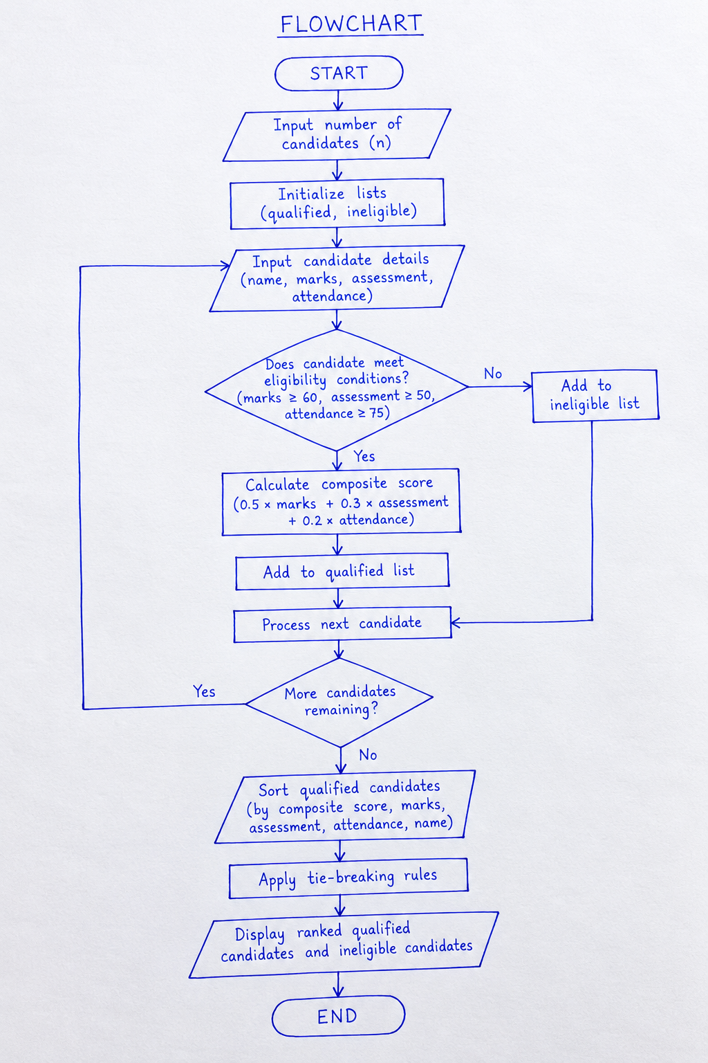
Flowchart:

Slide 16
Python Source Code
def is_eligible(marks, assessment, attendance):
return (
marks >= 60
and assessment >= 50
and attendance >= 75
)
def calculate_score(marks, assessment, attendance):
return (
0.5 * marks
+ 0.3 * assessment
+ 0.2 * attendance
)
def rank_key(candidate):
return (
-candidate["score"],
-candidate["marks"],
-candidate["assessment"],
-candidate["attendance"],
candidate["name"].lower()
)
def main():
candidates = [
{
"name": "Alice",
"marks": 85,
"assessment": 90,
"attendance": 95
},
{
"name": "Bob",
"marks": 75,
"assessment": 80,
"attendance": 78
},
{
"name": "Charlie",
"marks": 60,
"assessment": 50,
"attendance": 80
},
{
"name": "David",
"marks": 58,
"assessment": 70,
"attendance": 85
},
{
"name": "Eva",
"marks": 90,
"assessment": 95,
"attendance": 90
}
]
qualified = []
ineligible = []
for candidate in candidates:
if is_eligible(
candidate["marks"],
candidate["assessment"],
candidate["attendance"]
):
candidate["score"] = calculate_score(
candidate["marks"],
candidate["assessment"],
candidate["attendance"]
)
qualified.append(candidate)
else:
ineligible.append(candidate)
qualified.sort(key=rank_key)
print("RANKED QUALIFIED CANDIDATES")
for rank, candidate in enumerate(qualified, start=1):
print(
rank,
candidate["name"],
"- Score:",
round(candidate["score"], 2)
)
print("\\nINELIGIBLE CANDIDATES")
for candidate in ineligible:
print(candidate["name"])
if __name__ == "__main__":
main()

Slide 17
Test Cases
Test Case | Input | Expected Result
1 | Marks 60, assessment 50, attendance 75 | Eligible
2 | Marks 59, assessment 70, attendance 80 | Ineligible
3 | Equal composite scores, different marks | Higher marks ranked first
4 | Equal scores and marks, different assessment scores | Higher assessment ranked first
5 | All numerical criteria equal | Alphabetical order of names

Slide 18
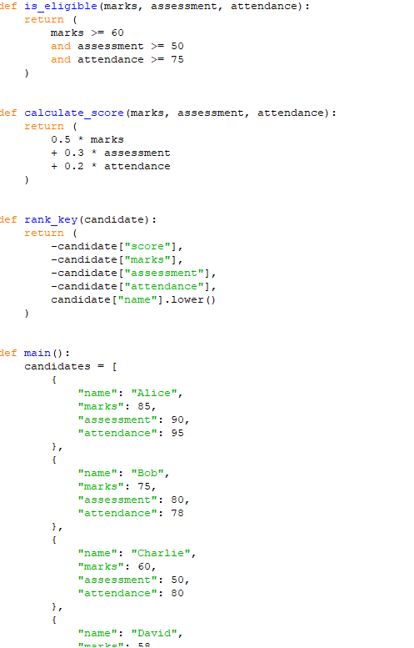
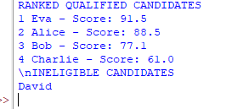
CODE and Output
CODE
OUTPUT

Slide 19
Conclusion
The Campus Event Seating and Entry Validation program demonstrates how Python can be used to manage seating arrangements and ticket validation efficiently.
Using nested lists, sets, loops, functions, and conditional statements, the program assigns seats, validates registration IDs, detects duplicate entries, identifies invalid tickets, and calculates available seating capacity.
This case study demonstrates the practical application of Python programming concepts to campus event management.

Slide 20
CASE-83:Food Supply Chain Stock Reconciliation
Problem Statement
Food supply chains distribute food items from central warehouses to multiple locations such as retail stores, distribution centers, and community kitchens. During transportation and distribution, discrepancies may occur due to damaged goods, incorrect entries, or stock shortages.
The objective of this project is to develop a Python program that compares quantities received, distributed, damaged, and remaining across several locations. The program identifies stock discrepancies and calculates the quantity that must be replenished at each location.

Slide 21
Objectives
Record food stock received at different locations.
Calculate the total quantity of food distributed.
Record damaged food quantities.
Calculate the expected remaining stock.
Compare expected stock with physically available stock.
Identify stock discrepancies and shortages.
Calculate replenishment requirements.
Display a stock reconciliation report.

Slide 22
Assumptions
Stock quantities are measured in kilograms (kg).
Each location has a recorded opening stock.
All quantities are non-negative numbers.
Damaged stock is not available for distribution.
Expected closing stock is calculated using opening stock, received stock, distributed stock, and damaged stock.
A discrepancy occurs when the actual closing stock differs from the expected closing stock.
The minimum required stock level is specified for each location.
Replenishment is calculated to restore stock to the minimum required level.

Slide 23
Algorithm
Start the program.
Enter the number of locations.
For each location, input the opening stock, received quantity, distributed quantity, damaged quantity, actual closing stock, and minimum stock level.
Calculate the total available stock.
Calculate expected closing stock.
Compare expected closing stock with actual closing stock.
Identify any stock discrepancy.
Calculate the replenishment quantity.
Display the reconciliation report for each location.
Display the overall totals.
Stop the program.

Slide 24
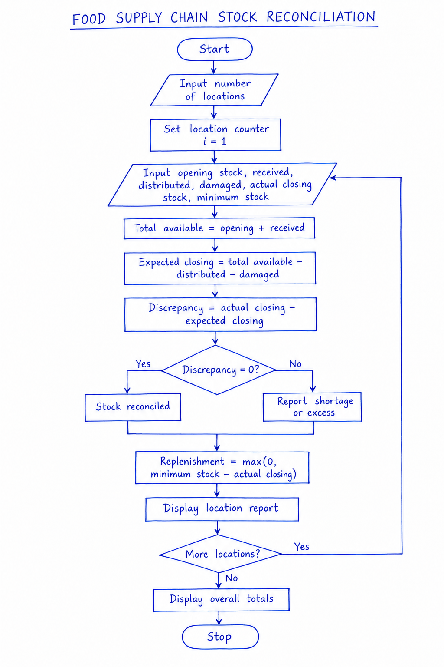
Flow Chart

Slide 25
Python Source Code
locations = int(input("Enter number of locations: "))
total_received = 0
total_distributed = 0
total_damaged = 0
total_replenishment = 0
for i in range(1, locations + 1):
print("\nLocation", i)
name = input("Enter location name: ")
opening = float(input("Enter opening stock (kg): "))
received = float(input("Enter received stock (kg): "))
distributed = float(input("Enter distributed stock (kg): "))
damaged = float(input("Enter damaged stock (kg): "))
actual = float(input("Enter actual closing stock (kg): "))
minimum = float(input("Enter minimum stock level (kg): "))
if min(opening, received, distributed,
damaged, actual, minimum) < 0:
print("Invalid input: quantities cannot be negative.")
print("Please run the program again.")
break
available = opening + received
expected = available - distributed - damaged
discrepancy = actual - expected
replenishment = max(0, minimum - actual)
print("\n--- Stock Reconciliation Report ---")
print("Location:", name)
print("Total available stock:", available, "kg")
print("Expected closing stock:", expected, "kg")
print("Actual closing stock:", actual, "kg")
print("Discrepancy:", discrepancy, "kg")
if discrepancy == 0:
print("Status: Stock reconciled")
elif discrepancy < 0:
print("Status: Stock shortage")
else:
print("Status: Excess stock")
print("Replenishment required:", replenishment, "kg")
total_received += received
total_distributed += distributed
total_damaged += damaged
total_replenishment += replenishment
else:
print("\n--- Overall Summary ---")
print("Total received:", total_received, "kg")
print("Total distributed:", total_distributed, "kg")
print("Total damaged:", total_damaged, "kg")
print("Total replenishment required:",
total_replenishment, "kg")

Slide 26
Test Cases
Test | Expected closing | Actual closing | Minimum stock | Expected result
1. Reconciled stock | 80 kg | 80 kg | 50 kg | No discrepancy; replenish 0 kg
2. Shortage | 80 kg | 70 kg | 50 kg | Shortage of 10 kg; replenish 0 kg
3. Excess stock | 80 kg | 90 kg | 50 kg | Excess of 10 kg; replenish 0 kg
4. Replenishment needed | 80 kg | 30 kg | 50 kg | No discrepancy; replenish 20 kg
5. Zero stock | 0 kg | 0 kg | 25 kg | No discrepancy; replenish 25 kg

Slide 27
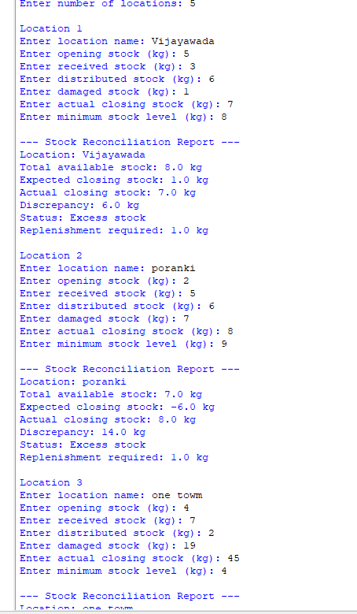
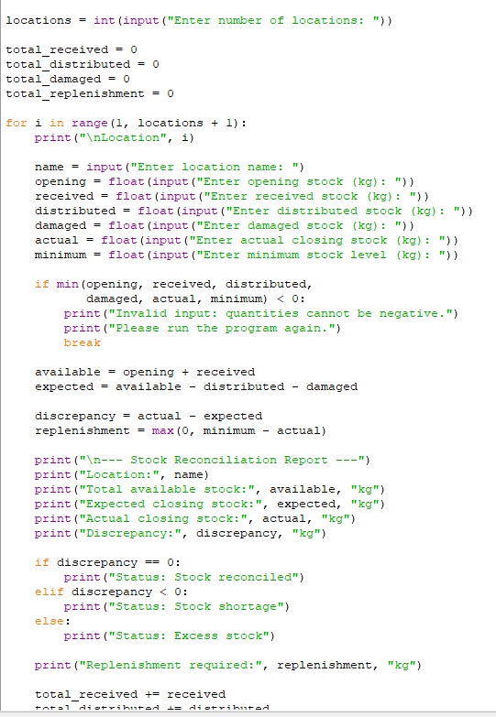
Screenshot of code and output
Code
Output

Slide 28
Conclusion
The Food Supply Chain Stock Reconciliation project demonstrates how Python can be used to manage inventory across multiple locations. The program calculates expected stock, compares it with actual stock, identifies shortages or excess stock, and determines replenishment requirements.
This system helps improve inventory accuracy, reduce food wastage, identify discrepancies, and support timely replenishment decisions. It uses basic Python concepts such as variables, arithmetic operators, conditional statements, loops, and formatted output.

Slide 29
CASE-84:Environmental Monitoring Data Analyzer
Problem Statement
Environmental monitoring involves collecting air-quality or water-quality readings from different locations and at different times. These readings are often stored in nested lists, making it necessary to process and analyze the data systematically.
The objective of this project is to develop a Python program that analyzes nested lists of environmental readings, calculates the average, minimum, and maximum values, and classifies observations according to user-supplied threshold values. The program helps identify normal and high-pollution readings and presents a summary of environmental conditions.

Slide 30
Objectives
Store environmental readings using nested lists.
Process readings from multiple locations.
Calculate the average of all readings.
Identify the minimum and maximum readings.
Accept threshold values from the user.
Classify each observation based on the thresholds.
Count the number of observations in each category.
Display a clear environmental monitoring report.

Slide 31
Assumptions
Readings are represented as numeric values.
Each inner list represents observations from one monitoring location.
All locations contain at least one reading.
Threshold values are supplied by the user.
A reading below the lower threshold is classified as Low.
A reading between the lower and upper thresholds, inclusive, is classified as Normal.
A reading above the upper threshold is classified as High.
This is a demonstration of threshold-based classification, not an official environmental safety assessment.

Slide 32
Algorithm
Start the program.
Input the number of monitoring locations.
Enter the lower and upper threshold values.
Create a nested list to store readings for each location.
Calculate the average, minimum, and maximum for each location.
Classify every reading using the threshold values.
Count the observations in each category.
Display the report for each location.
Calculate the overall average, minimum, and maximum.
Display the overall environmental monitoring summary.
Stop the program.

Slide 33
Python Source Code
data = []
locations = int(input("Enter number of locations: "))
lower = float(input("Enter lower threshold: "))
upper = float(input("Enter upper threshold: "))
if locations <= 0 or lower > upper:
print("Invalid number of locations or thresholds.")
else:
for i in range(locations):
name = input("\nEnter location name: ")
values = input(
"Enter readings separated by commas: "
)
readings = [float(x.strip())
for x in values.split(",")]
if not readings:
print("No readings entered.")
continue
data.append([name, readings])
total = []
counts = {"Low": 0, "Normal": 0, "High": 0}
for name, readings in data:
avg = sum(readings) / len(readings)
maximum = max(readings)
minimum = min(readings)
print("\nLocation:", name)
print("Readings:", readings)
print("Average:", round(avg, 2))
print("Maximum:", maximum)
print("Minimum:", minimum)
for value in readings:
if value < lower:
category = "Low"
elif value <= upper:
category = "Normal"
else:
category = "High"
counts[category] += 1
print(value, "->", category)
total.extend(readings)
if total:
print("\n--- Overall Summary ---")
print("Total readings:", len(total))
print("Overall average:",
round(sum(total) / len(total), 2))
print("Overall maximum:", max(total))
print("Overall minimum:", min(total))
print("Low readings:", counts["Low"])
print("Normal readings:", counts["Normal"])
print("High readings:", counts["High"])

Slide 34
Test Cases
Test reading | Expected category
25 | Low
50 | Normal
75 | Normal
100 | Normal
125 | High

Slide 35
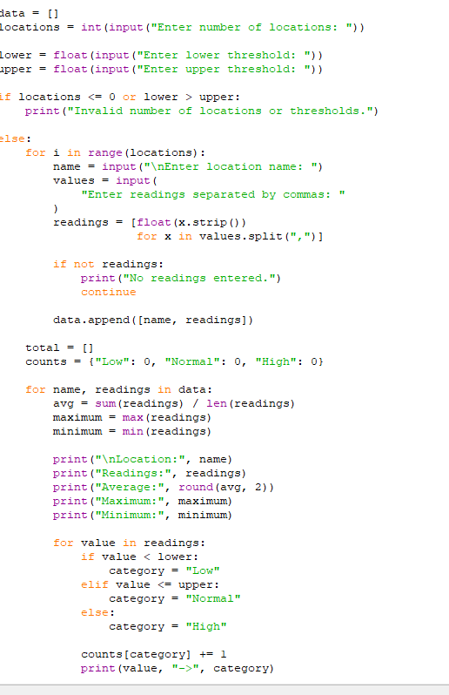
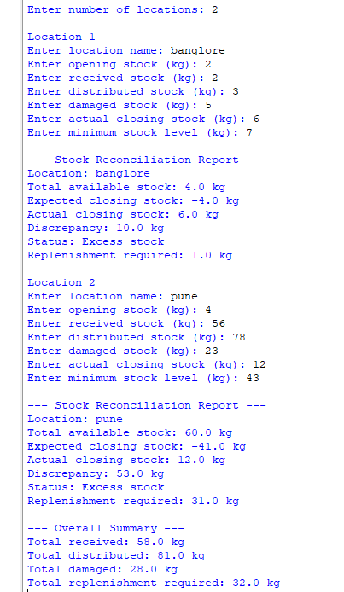
Screenshot of Code and Output
Code
Ouput

Slide 36
Conclusion
The Environmental Monitoring Data Analyzer demonstrates how Python can be used to process and analyze environmental data stored in nested lists. It calculates average, minimum, and maximum readings and classifies observations using user-defined threshold values.
This project helps summarize environmental measurements, identify unusual readings, and support environmental monitoring decisions. It demonstrates the practical use of lists, nested lists, loops, conditional statements, and built-in functions in Python.

Slide 37
CASE-84: Smart Classroom Timetable Allocation
Problem Statement
Educational institutions must allocate courses to classrooms and time periods while satisfying classroom capacity and timetable constraints. Incorrect allocation may result in classroom clashes, overlapping classes, or rooms that cannot accommodate the required number of students.
The objective of this project is to develop a Python program that represents courses, classrooms, and time periods using lists and tuples. The program validates classroom capacities, detects timetable clashes, and determines whether all courses can be accommodated under the specified constraints.

Slide 38
Ojectives
Represent courses, classrooms, and periods using Python lists and tuples.
Store the number of students enrolled in each course.
Validate classroom capacity requirements.
Assign courses to suitable classrooms and time periods.
Detect classroom clashes and overlapping course schedules.
Ensure that a course is not assigned to an unsuitable room.
Check whether all courses can be accommodated.
Display the final timetable and any allocation failures

Slide 39
Assumptions
Each course has a unique course ID and a known student count.
Each classroom has a unique room ID and a fixed seating capacity.
Time periods are represented by unique identifiers.
A classroom can host only one course during a period.
A course is scheduled only once in the timetable.
The classroom capacity must be greater than or equal to the course enrollment.
A course can be allocated only if a suitable room and an available period exist.
For this basic model, each course occupies one classroom for one period.

Slide 40
Algorithm
Start the program.
Store course details, room capacities, and available periods using lists and tuples.
Check whether each course has at least one classroom with sufficient capacity.
Initialize an empty timetable.
Select an unscheduled course.
Search for a suitable classroom and an available period.
Check whether the room-period combination is already occupied.
If no clash exists, allocate the course and store the assignment as a tuple.
If no suitable assignment is available, report that the course could not be scheduled.
Repeat until all courses are processed.
Display the timetable, clashes, and any unallocated courses.
Stop the program.

Slide 41
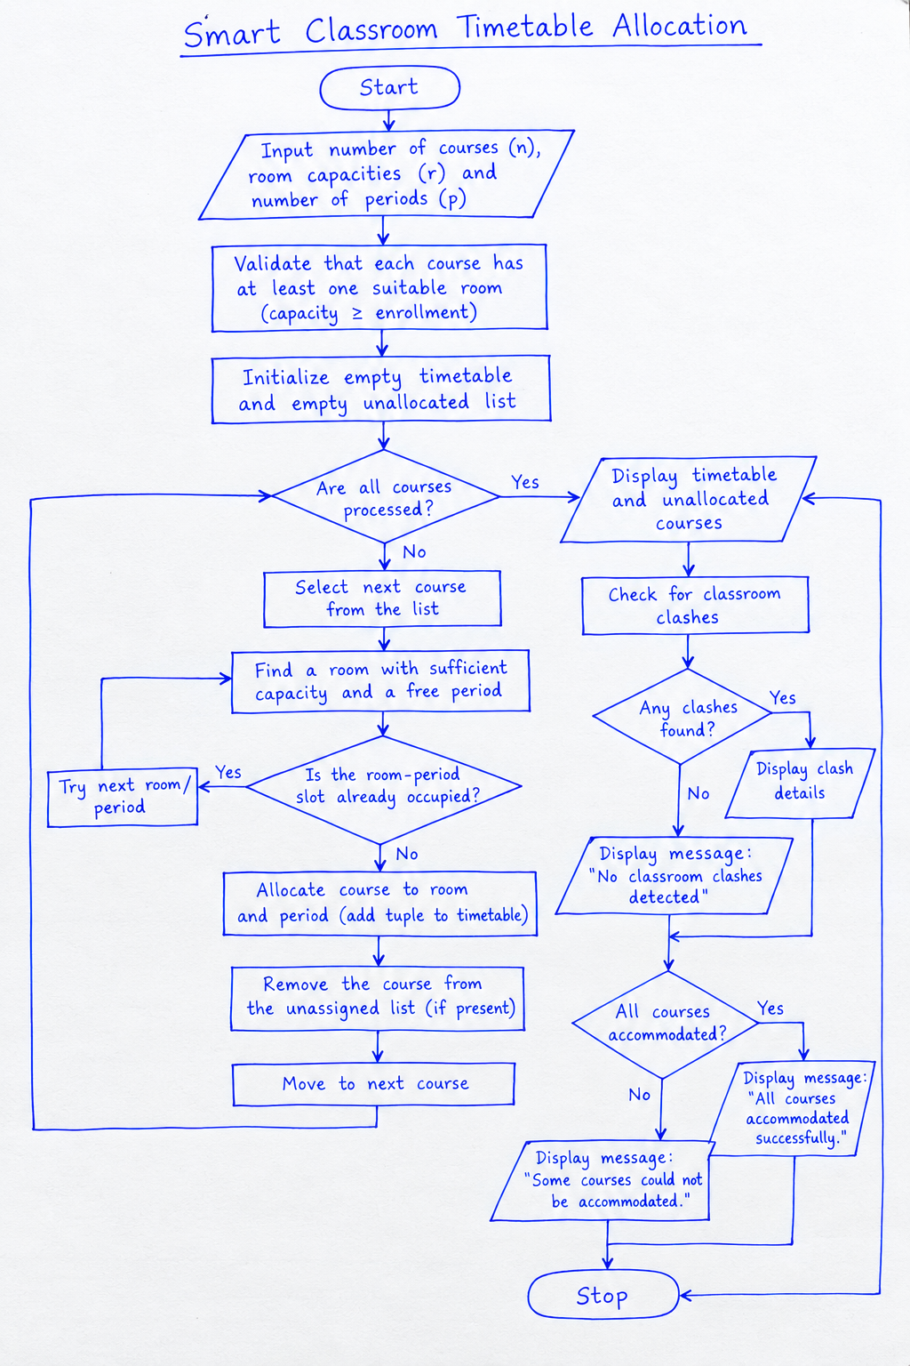
Flowchart

Slide 42
Python Source Code
courses = [
("Python", 55),
("Mathematics", 40),
("Physics", 65),
("English", 30)
]
rooms = [
("Room A", 40),
("Room B", 60),
("Room C", 80)
]
periods = ["9 AM", "10 AM", "11 AM"]
# Each timetable entry is (course, room, period)
timetable = []
unallocated = []
# Validate whether every course has a suitable room
for course, students in courses:
suitable = [
room for room, capacity in rooms
if capacity >= students
]
if not suitable:
print(course, "has no suitable classroom.")
# Allocate courses using available room-period slots
for course, students in courses:
assigned = False
# Try smaller suitable rooms first
suitable_rooms = sorted(
[r for r in rooms if r[1] >= students],
key=lambda r: r[1]
)
for room, capacity in suitable_rooms:
for period in periods:
clash = any(
entry[1] == room and entry[2] == period
for entry in timetable
)
if not clash:
timetable.append(
(course, room, period)
)
assigned = True
break
if assigned:
break
if not assigned:
unallocated.append(course)
# Display final timetable
print("\n--- FINAL TIMETABLE ---")
for course, room, period in timetable:
print(course, "->", room, "->", period)
# Detect any clashes in the final timetable
print("\n--- CLASH CHECK ---")
clashes = []
for i in range(len(timetable)):
for j in range(i + 1, len(timetable)):
if (timetable[i][1] == timetable[j][1]
and timetable[i][2] == timetable[j][2]):
clashes.append((timetable[i], timetable[j]))
if clashes:
for clash in clashes:
print("Clash detected:", clash)
else:
print("No classroom clashes detected.")
# Check overall feasibility
print("\n--- ALLOCATION RESULT ---")
if not unallocated:
print("All courses accommodated successfully.")
else:
print("Unallocated courses:", unallocated)
print("All courses could not be accommodated.")

Slide 43
Test Cases
Test case | Input condition | Expected result
1 | Every course fits in a room | Allocate all courses
2 | Course enrollment exceeds every room capacity | Mark course unallocated
3 | A room is already occupied in a period | Assign a different free room or period
4 | More courses than available room-period slots | Some courses remain unallocated
5 | No courses are provided | Display an empty timetable

Slide 44
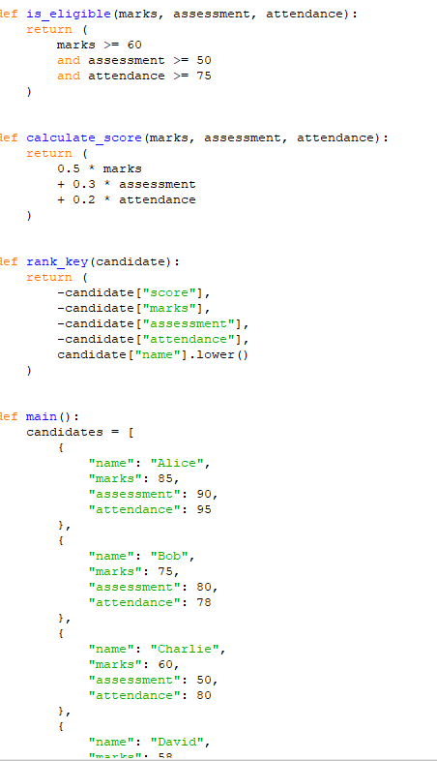
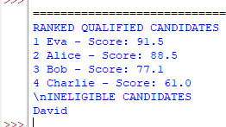
Screenshot of code and output
Code
Output

Slide 45
Conclusion
The Smart Classroom Timetable Allocation project demonstrates how Python can be used to organize classroom schedules efficiently. Lists and tuples are used to represent courses, classrooms, periods, and timetable assignments.
The program validates room capacities, detects classroom clashes, and determines whether all courses can be accommodated under the specified constraints. This approach helps reduce scheduling conflicts and improves classroom utilization. More advanced scheduling algorithms can be used to handle complex institutional timetables.

Slide 46
CASE-86: Multi-Stage ATM Transaction Audit
Problem Statement
ATM systems process different types of financial transactions, including deposits, withdrawals, and transfers. Each transaction must be validated to ensure that account balances remain correct and that invalid operations are rejected.
The objective of this project is to develop a Python program that processes a sequence of ATM transactions in multiple stages, maintains account balances, detects invalid operations such as insufficient funds or invalid amounts, and identifies suspicious repeated transaction patterns for further review.

Slide 47
Objectives
Simulate bank accounts with initial balances.
Process deposits, withdrawals, and transfers.
Validate every transaction before processing it.
Maintain accurate balances after each valid transaction.
Detect insufficient funds and invalid transaction amounts.
Record transaction details and audit results.
Identify repeated transactions that may require review.
Generate a final transaction audit report.

Slide 48
Assumptions
Each account has a unique account ID and an initial balance.
All transaction amounts must be positive.
Deposits increase the account balance.
Withdrawals decrease the balance only when sufficient funds are available.
Transfers debit the sender and credit the receiver only when the transfer is valid.
Invalid transactions do not change any account balance.
Repeated transactions of the same type and amount on the same account within the transaction sequence are flagged for review.
A suspicious-pattern alert is an indicator for manual review, not proof of fraud.

Slide 49
Algorithm
Start the program.
Initialize account balances and transaction history.
Input the number of transactions.
Read the transaction type, account IDs, and amount.
Validate the transaction amount and account details.
For a deposit, add the amount to the account balance.
For a withdrawal, check the available balance before deducting the amount.
For a transfer, validate both accounts and the sender's balance before updating either account.
Record the transaction result and updated balance.
Check the transaction history for repeated patterns.
Display invalid transactions, suspicious-pattern alerts, and final balances.
Stop the program.

Slide 50
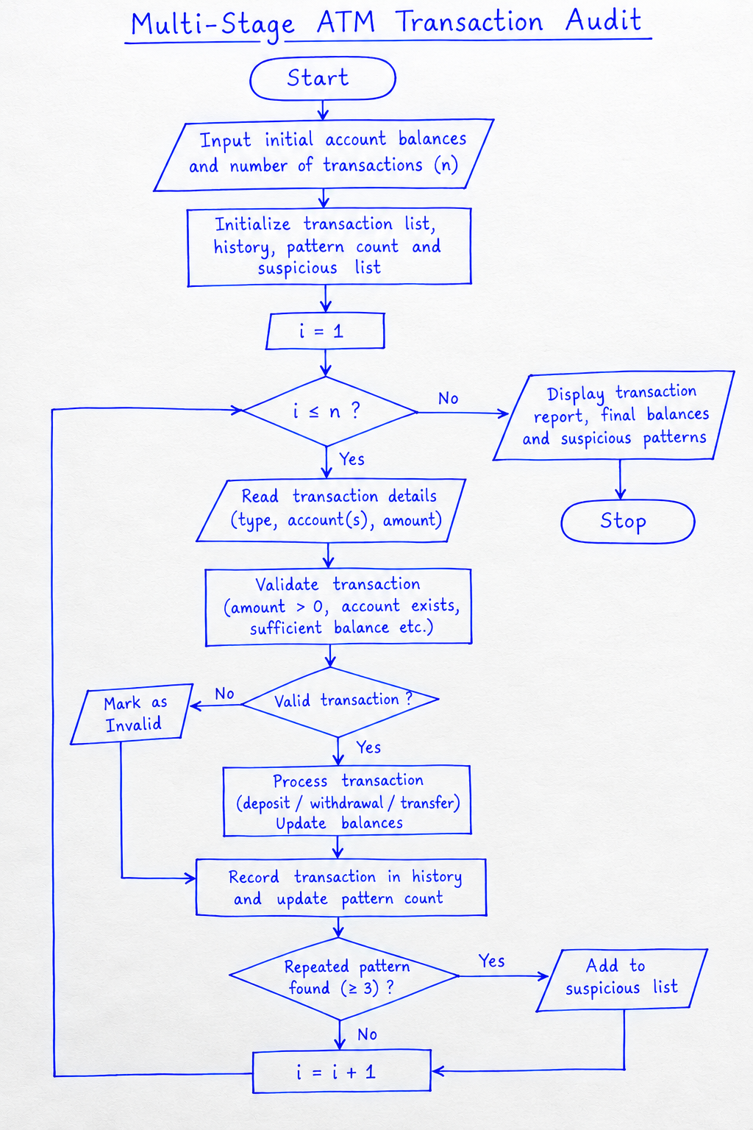
Flow chart

Slide 51
Python source code
t
accounts = {
"A101": 1000.0,
"A102": 500.0
}
transactions = [
("DEPOSIT", "A101", 200),
("WITHDRAW", "A101", 100),
("TRANSFER", "A101", "A102", 150),
("WITHDRAW", "A101", 100),
("WITHDRAW", "A101", 100),
("WITHDRAW", "A101", 5000),
("DEPOSIT", "A102", -50)
]
history = []
pattern_count = {}
suspicious = []
for txn in transactions:
action = txn[0]
valid = False
pattern = None
if action == "DEPOSIT":
_, account, amount = txn
pattern = (action, account, amount)
if account in accounts and amount > 0:
accounts[account] += amount
valid = True
elif action == "WITHDRAW":
_, account, amount = txn
pattern = (action, account, amount)
if account not in accounts or amount <= 0:
pass
elif accounts[account] >= amount:
accounts[account] -= amount
valid = True
elif action == "TRANSFER":
_, source, target, amount = txn
pattern = (action, source, target, amount)
if (source in accounts and target in accounts
and source != target and amount > 0
and accounts[source] >= amount):
accounts[source] -= amount
accounts[target] += amount
valid = True
else:
print("Unknown transaction type:", action)
if pattern is not None:
pattern_count[pattern] = (
pattern_count.get(pattern, 0) + 1
)
if pattern_count[pattern] == 3:
suspicious.append(pattern)
history.append((txn, "Valid" if valid else "Invalid"))
print(txn, "->", "Accepted" if valid else "Rejected")
print("\n--- TRANSACTION AUDIT REPORT ---")
for txn, status in history:
print(txn, ":", status)
print("\n--- FINAL ACCOUNT BALANCES ---")
for account, balance in accounts.items():
print(account, ":", round(balance, 2))
print("\n--- SUSPICIOUS PATTERN REPORT ---")
if suspicious:
for pattern in suspicious:
print("Repeated pattern (3 or more attempts):", pattern)
else:
print("No repeated patterns detected.")

Slide 52
Test Cases
Test case | Input condition | Expected result
1 | Deposit a positive amount | Balance increases
2 | Withdraw within available balance | Balance decreases
3 | Withdraw more than available balance | Transaction rejected
4 | Deposit a negative amount | Transaction rejected
5 | Transfer between two valid accounts with sufficient funds | Both balances update
6 | Transfer to an unknown account | Transaction rejected
7 | Repeat the same transaction pattern three times | Suspicious-pattern alert

Slide 53
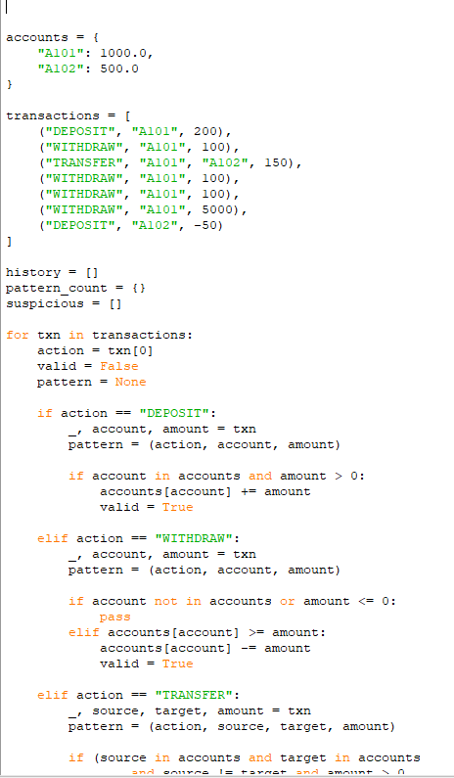
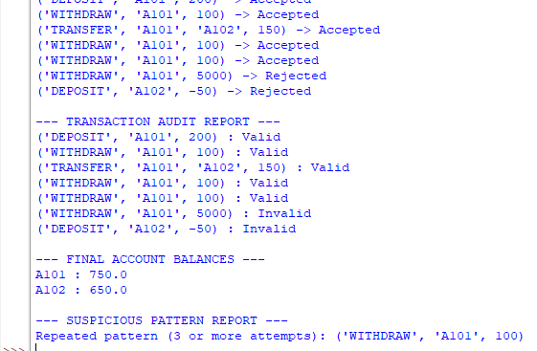
Screenshot of code and output
Code
Output

Slide 54
Conclusion
The Multi-Stage ATM Transaction Audit project demonstrates how Python can simulate basic banking operations and maintain accurate account balances. The program processes deposits, withdrawals, and transfers while validating transaction amounts, account details, and available funds.
It also maintains transaction history and identifies repeated transaction patterns for further review. This project demonstrates the practical application of lists, tuples, dictionaries, loops, conditional statements, and basic auditing techniques in Python.

Slide 55
CASE-87:Examination Question Difficulty and Performance Analysis
Problem Statement
Examination performance analysis helps teachers understand how students perform on individual questions and identify topics that may require additional attention.
The objective of this project is to develop a Python program that compares student answer strings against an answer key, calculates question-wise success rates, identifies the most frequently missed questions, and classifies question performance based on user-defined thresholds. The program provides a summary that helps evaluate question difficulty and overall student performance.

Slide 56
Objectives
Store the correct answers in an answer key.
Store student responses using nested lists.
Compare each student's answer with the corresponding correct answer.
Calculate the number of correct and incorrect answers per question.
Calculate the success rate for every question.
Identify the most frequently missed questions.
Classify questions as Easy, Moderate, or Difficult.
Display a question-wise performance report.

Slide 57
Assumptions
Each question has one correct answer stored in the answer key.
Student responses are represented as strings.
Answers are compared without distinguishing uppercase and lowercase letters.
A blank or incorrect response is counted as an incorrect answer.
All students are evaluated against the same answer key.
Success rate is calculated as the percentage of students who answered a question correctly.
Difficulty categories are based on configurable success-rate thresholds.
The analysis measures observed student performance, which may indicate question difficulty but does not prove it by itself.

Slide 58
Algorithm
Start the program.
Input the number of students, questions, and the correct answer key.
Initialize the correct-answer count for each question.
Read each student's answer string.
Compare each response with the corresponding answer key.
Update the correct and incorrect counts for every question.
Calculate the success rate for each question.
Identify the question with the highest number of incorrect answers.
Classify question performance based on the success rate.
Display the success rates, most frequently missed questions, and classifications.
Stop the program.

Slide 59
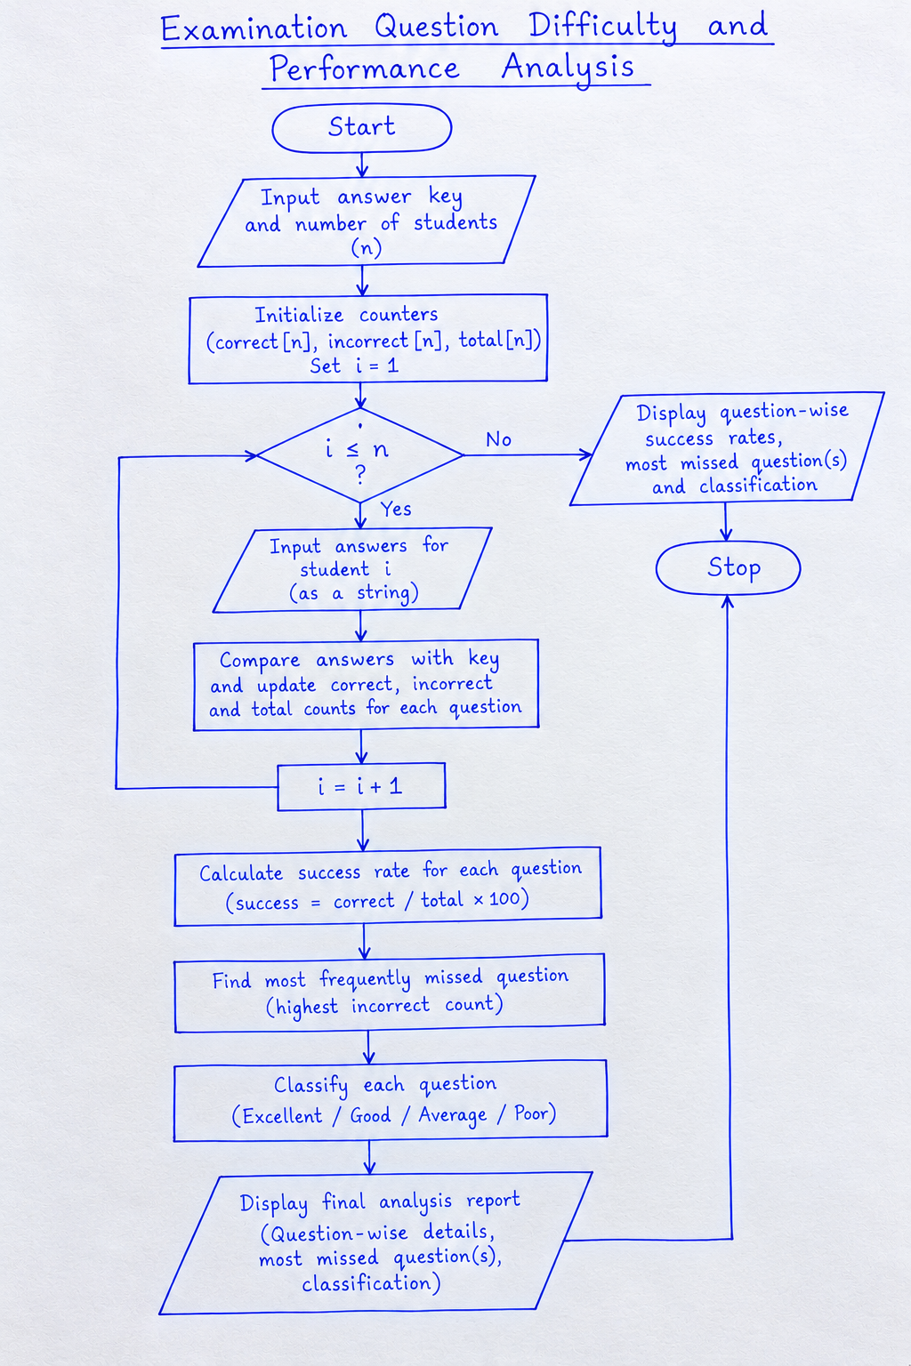
Flowchart

Slide 60
Python code
# Examination Question Difficulty and Performance Analysis
key = [
x.strip().upper()
for x in input(
"Enter answer key separated by commas: "
).split(",")
]
if not key or any(x == "" for x in key):
print("Invalid answer key.")
else:
students = int(input("Enter number of students: "))
if students <= 0:
print("Number of students must be positive.")
else:
correct = [0] * len(key)
total = [0] * len(key)
for i in range(students):
while True:
answers = [
x.strip().upper()
for x in input(
f"Student {i + 1} answers: "
).split(",")
]
if len(answers) == len(key):
break
print("Enter exactly", len(key), "answers.")
for j in range(len(key)):
total[j] += 1
if answers[j] == key[j]:
correct[j] += 1
rates = []
print("\n--- QUESTION-WISE ANALYSIS ---")
for j in range(len(key)):
rate = correct[j] / total[j] * 100
missed = total[j] - correct[j]
rates.append(rate)
if rate >= 80:
category = "Excellent"
elif rate >= 60:
category = "Good"
elif rate >= 40:
category = "Average"
else:
category = "Poor"
print(f"\nQuestion {j + 1}")
print("Correct:", correct[j])
print("Incorrect:", missed)
print("Success rate:", round(rate, 2), "%")
print("Classification:", category)
most_missed = max(
total[j] - correct[j]
for j in range(len(key))
)
print("\n--- MOST FREQUENTLY MISSED ---")
for j in range(len(key)):
missed = total[j] - correct[j]
if missed == most_missed:
print(f"Question {j + 1}: {missed} missed")
print("\nAnalysis completed.")

Slide 61
Test cases
Question | Student answers | Expected correct | Expected missed
Q1 | A, A, A, B | 3 | 1
Q2 | B, C, A, D | 1 | 3
Q3 | C, C, C, C | 4 | 0
Q4 | D, D, B, A | 2 | 2

Slide 62
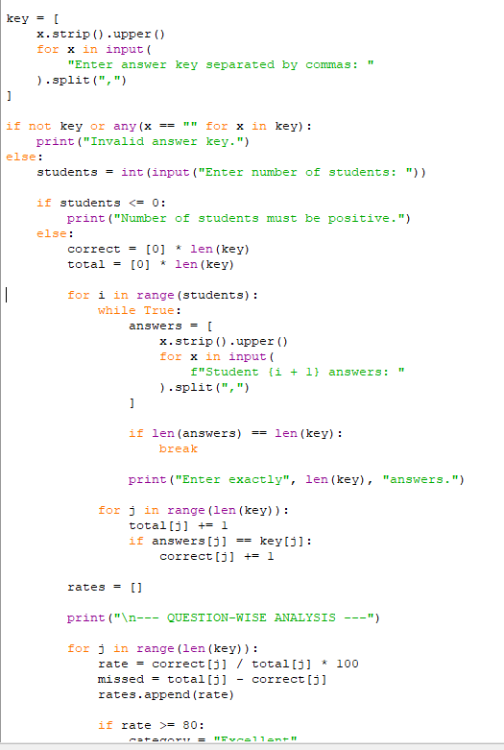
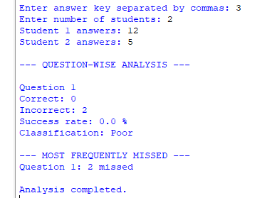
Screenshot of Code and Output
CODE
OUTPUT

Slide 63
Conclusion
The Examination Question Difficulty and Performance Analysis project demonstrates how Python can be used to evaluate student responses systematically. By comparing answer strings against an answer key, the program calculates question-wise success rates, counts incorrect responses, identifies the most frequently missed questions, and classifies question performance.
This analysis helps teachers identify questions that may require review and topics where students may need additional support. The project demonstrates the practical application of lists, strings, loops, conditional statements, and arithmetic operations in Python.

Slide 64
CASE-88:Multi-Branch Retail Inventory Transfer
Problem Statement
Retail businesses operate multiple branches that maintain different stock levels for the same products. Some branches may have excess stock, while others may experience shortages compared with their target stock levels.
The objective of this project is to develop a Python program that compares branch-level stock lists with target stock levels, calculates surpluses and shortages, and generates stock transfer recommendations between branches while respecting the specified transfer constraints.

Slide 65
Objectives
Store inventory details for multiple retail branches.
Define target stock levels for each product.
Calculate surplus and shortage quantities.
Identify branches with excess stock.
Identify branches requiring additional stock.
Generate suitable stock transfers between branches.
Respect the maximum transfer quantity.
Update inventory balances after each transfer.
Display the final inventory and transfer report.

Slide 66
Assumptions
Each branch maintains stock quantities for different products.
Each product has a predefined target stock level.
Inventory quantities are non-negative integers.
Surplus occurs when current stock exceeds target stock.
Shortage occurs when current stock is below target stock.
Transfers are made only between different branches for the same product.
A branch cannot transfer more than its available surplus.
A receiving branch cannot receive more than its shortage.
Each individual transfer must not exceed the specified maximum quantity.
Stock balances are updated after every valid transfer.

Slide 67
Algorithm
Start the program.
Input branch inventories, target stock levels, and the maximum transfer quantity.
Compare current stock with target stock for each product.
Calculate surpluses and shortages.
Select a branch with surplus stock.
Find a branch with a shortage of the same product.
Calculate the transfer quantity.
Validate the transfer constraints.
Update the stock balances of both branches.
Record the transfer details.
Repeat until no eligible transfers remain.
Display the transfer report and final inventory.
Stop the program.

Slide 68
Python code
# Multi-Branch Retail Inventory Transfer
branches = {
"Branch A": {"Rice": 80, "Oil": 20},
"Branch B": {"Rice": 25, "Oil": 60},
"Branch C": {"Rice": 45, "Oil": 30}
}
targets = {
"Rice": 50,
"Oil": 40
}
max_transfer = 15
transfers = []
# Process each product
for product, target in targets.items():
surplus = {}
shortage = {}
# Calculate surplus and shortage
for branch, stock in branches.items():
quantity = stock.get(product, 0)
if quantity > target:
surplus[branch] = quantity - target
elif quantity < target:
shortage[branch] = target - quantity
# Transfer stock between branches
for donor in list(surplus.keys()):
for receiver in list(shortage.keys()):
if surplus[donor] <= 0:
break
if shortage[receiver] <= 0:
continue
quantity = min(
surplus[donor],
shortage[receiver],
max_transfer
)
if quantity > 0:
# Update inventory
branches[donor][product] -= quantity
branches[receiver][product] += quantity
# Record transfer as a tuple
transfers.append(
(product, donor, receiver, quantity)
)
surplus[donor] -= quantity
shortage[receiver] -= quantity
# Display transfer report
print("\n--- INVENTORY TRANSFERS ---")
if transfers:
for product, donor, receiver, quantity in transfers:
print(
product, ":", donor, "->", receiver,
"| Quantity:", quantity
)
else:
print("No transfers required.")
# Display final inventory
print("\n--- FINAL BRANCH INVENTORY ---")
for branch, stock in branches.items():
print(branch, ":", stock)
# Display remaining surplus and shortage
print("\n--- FINAL STOCK STATUS ---")
for branch, stock in branches.items():
for product, target in targets.items():
quantity = stock.get(product, 0)
if quantity < target:
print(
branch, product,
"Shortage:", target - quantity
)
elif quantity > target:
print(
branch, product,
"Surplus:", quantity - target
)
else:
print(branch, product, "Stock at target")
print("\nInventory transfer analysis completed.")

Slide 69
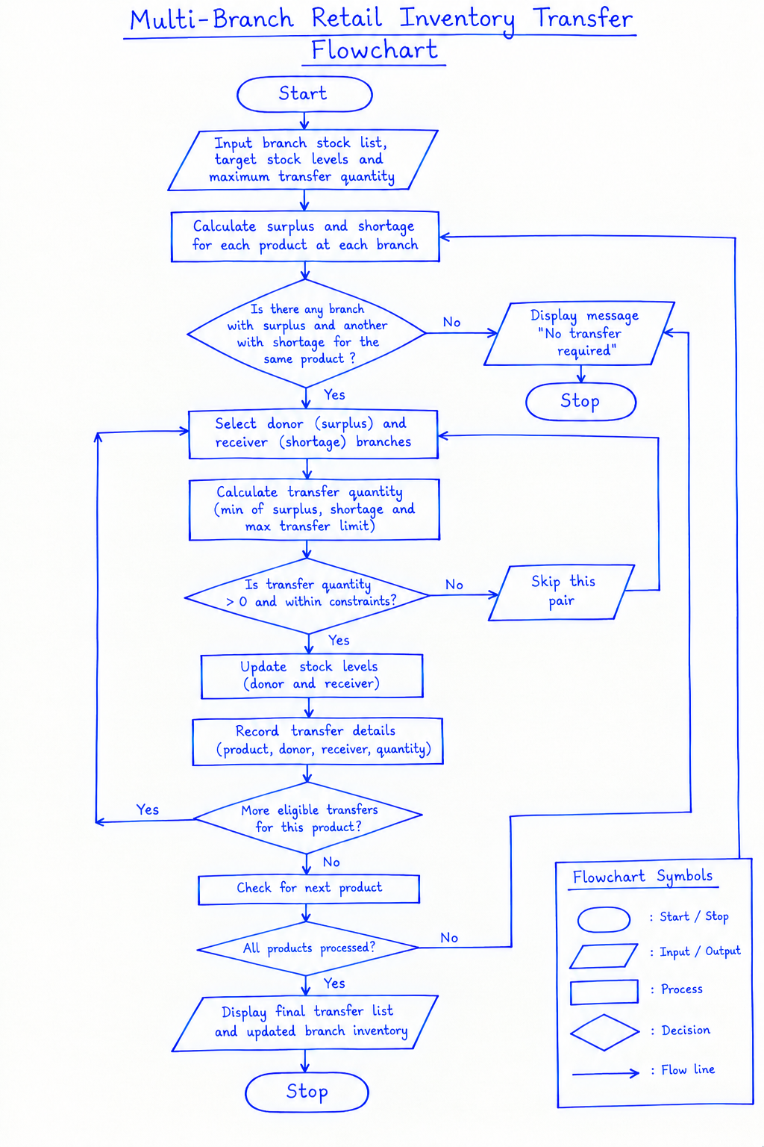
Flowchart

Slide 70
Test Cases
Test case | Input condition | Expected result
1 | One branch has surplus and another has shortage | Transfer is generated
2 | Surplus exceeds the transfer limit | Transfer respects the maximum limit
3 | All branches meet target stock | No transfer required
4 | Total stock is insufficient | Remaining shortages are reported
5 | Branch stock is below target | Shortage is identified
6 | Branch stock is above target | Surplus is identified

Slide 71
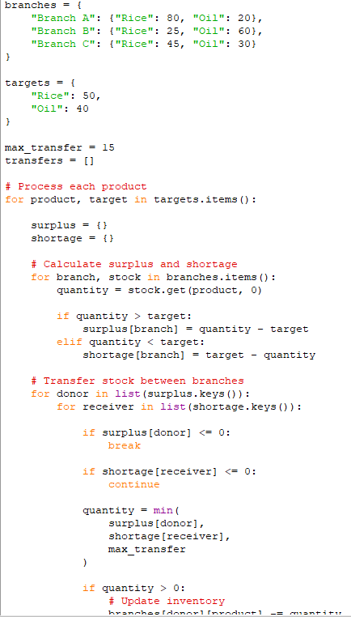
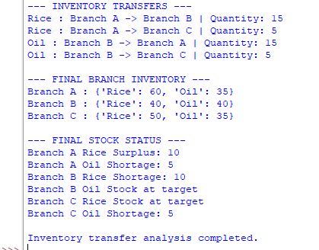
Screenshot of code and output
CODE
OUTPUT

Slide 72
Conclusion
The Multi-Branch Retail Inventory Transfer project demonstrates how Python can be used to manage inventory across multiple retail branches. The program calculates surpluses and shortages, generates suitable transfer recommendations, respects transfer quantity constraints, and updates stock balances.
This approach helps reduce excess inventory, address stock shortages, and improve inventory utilization. The project demonstrates the practical application of lists, tuples, dictionaries, loops, conditional statements, and built-in functions in Python.

Slide 73
CASE-89:University Hostel Room Allocation
Problem Statement
Universities need to allocate students to hostel rooms according to room capacity, eligibility requirements, and grouping constraints. Incorrect allocation can lead to overcrowded rooms, unsuitable assignments, and duplicate room allotments.
The objective of this project is to develop a Python program that allocates students to eligible hostel rooms, keeps specified student groups together, detects duplicate assignments, and calculates the number of students who remain unallocated because of limited room availability or eligibility restrictions.

Slide 74
Objectives
Store student details and hostel room information.
Represent student groups and room capacities using Python lists, tuples, and dictionaries.
Allocate students according to room capacity.
Check room eligibility before assigning students.
Keep students in specified groups together.
Detect duplicate student assignments.
Prevent room capacity from being exceeded.
Calculate the total number of unallocated students.
Display the final room allocation report.

Slide 75
Assumptions
Each student has a unique student ID.
Each room has a fixed capacity and eligibility criteria.
Students are organized into groups that should stay together.
A group is allocated to a room only if the entire group fits.
A room must be eligible for the group's category.
A student must not be assigned more than once.
Room capacity must never be exceeded.
Students who cannot be assigned to a suitable room are counted as unallocated.
The program uses a simple allocation strategy and does not guarantee an optimal solution for every possible arrangement.

Slide 76
Algorithm
Start the program.
Input student groups, room capacities, and eligibility requirements.
Initialize the room allocation list and duplicate-assignment records.
Select a student group.
Check whether any student ID has already been assigned.
Find a room that satisfies eligibility and capacity constraints.
If a suitable room is available, assign the entire group to it.
Update the room's occupied capacity.
If no suitable room is available, add the group to the unallocated list.
Repeat until all groups are processed.
Display room assignments, duplicate IDs, and unallocated student demand.
Stop the program.

Slide 77
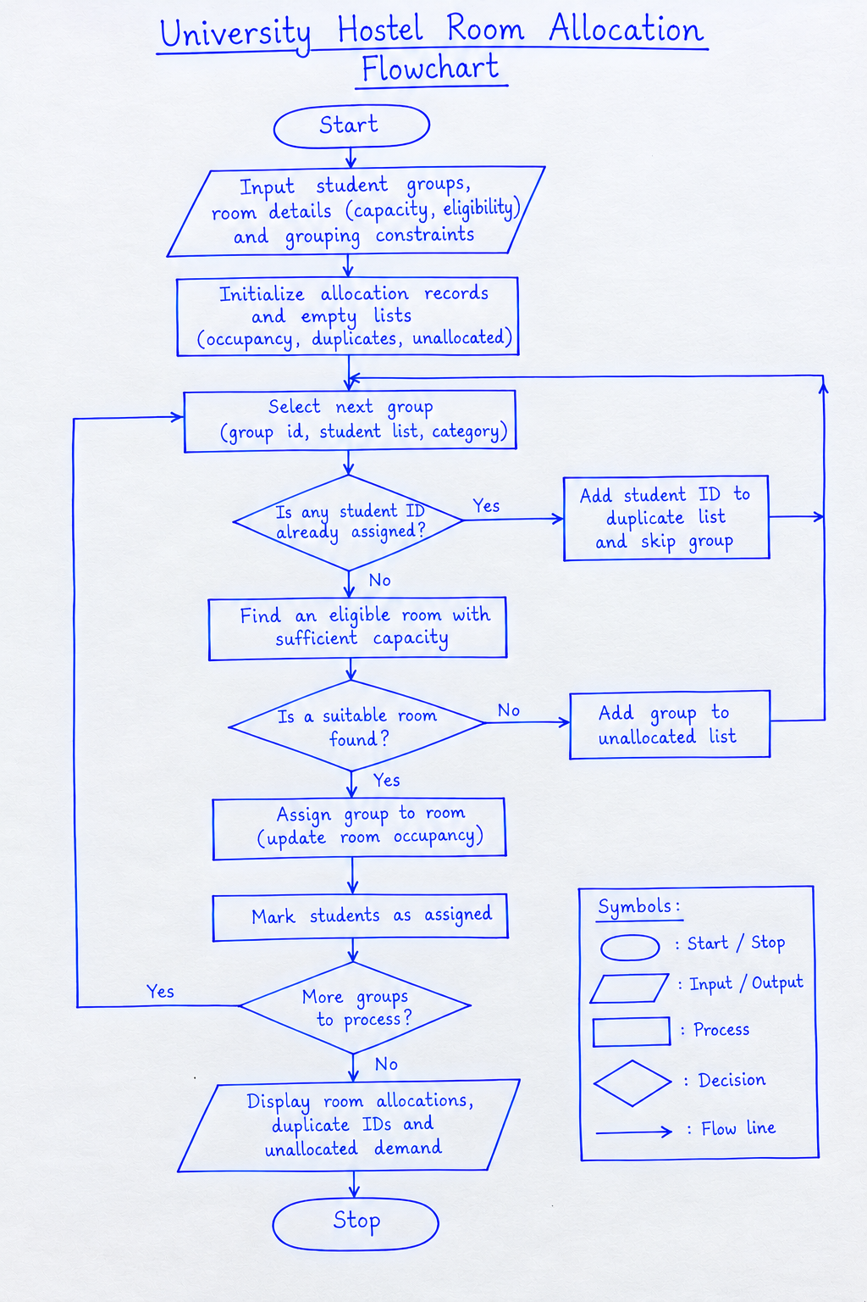
Flow chart

Slide 78
Python source code
# University Hostel Room Allocation
# Student groups: (group_id, student_ids, category)
groups = [
("G1", ["S101", "S102"], "UG"),
("G2", ["S103", "S104", "S105"], "UG"),
("G3", ["S106", "S107"], "PG"),
("G4", ["S108", "S109", "S110"], "PG"),
("G5", ["S102", "S111"], "UG")
]
# Room details: capacity and eligible categories
rooms = {
"Room A": {"capacity": 3, "eligible": ["UG"]},
"Room B": {"capacity": 2, "eligible": ["PG"]},
"Room C": {"capacity": 4, "eligible": ["UG", "PG"]}
}
# Initialize allocation records
occupancy = {room: [] for room in rooms}
allocations = []
seen_students = set()
assigned_students = set()
duplicate_ids = set()
# Allocate each group
for group_id, students, category in groups:
# Detect duplicate student IDs across groups
duplicates = [
student for student in students
if student in seen_students
]
if duplicates:
duplicate_ids.update(duplicates)
print("Duplicate assignment detected:",
group_id, duplicates)
continue
seen_students.update(students)
allocated = False
# Find a room satisfying eligibility and capacity
for room, details in rooms.items():
available = (
details["capacity"] - len(occupancy[room])
)
if (category in details["eligible"]
and len(students) <= available):
occupancy[room].extend(students)
assigned_students.update(students)
allocations.append(
(group_id, room, students)
)
print(group_id, "allocated to", room)
allocated = True
break
if not allocated:
print(group_id, "could not be allocated")
# Display final room allocations
print("\n--- FINAL ROOM ALLOCATION ---")
for room, students in occupancy.items():
print(room, ":", students)
print("Occupied:", len(students),
"/", rooms[room]["capacity"])
# Display duplicate IDs
print("\n--- DUPLICATE ASSIGNMENTS ---")
if duplicate_ids:
for student in sorted(duplicate_ids):
print("Duplicate student ID:", student)
else:
print("No duplicates detected.")
# Calculate unallocated demand using unique student IDs
all_students = {
student
for group_id, students, category in groups
for student in students
}
unallocated = all_students - assigned_students
print("\n--- UNALLOCATED STUDENTS ---")
print(sorted(unallocated))
print("Unallocated demand:", len(unallocated))
print("Allocated students:", len(assigned_students))
print("Total unique students:", len(all_students))
print("\nHostel allocation analysis completed.")

Slide 79
Test Cases
Test case | Input condition | Expected result
1 | Group fits in an eligible room | Group allocated successfully
2 | Group exceeds available room capacity | Group remains unallocated
3 | Room is not eligible for the group | Room is not selected
4 | Student ID appears in multiple groups | Duplicate assignment detected
5 | All rooms are full | Remaining demand is reported
6 | All groups fit eligible rooms | All students are allocated

Slide 80
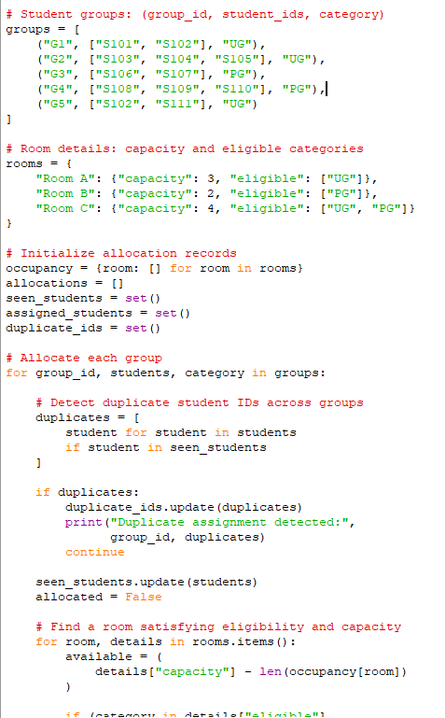
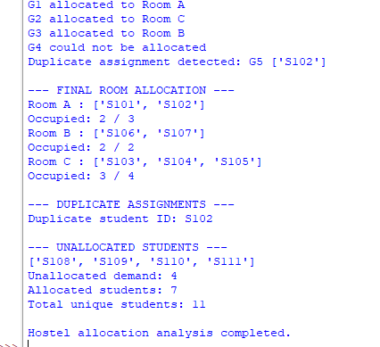
Screenshots of code and output
CODE
OUTPUT

Slide 81
Conclusion
The University Hostel Room Allocation project demonstrates how Python can be used to allocate students to hostel rooms while satisfying capacity, eligibility, and grouping constraints.
The program detects duplicate student IDs, prevents room overcapacity, and calculates unallocated student demand. It demonstrates the practical application of lists, tuples, dictionaries, sets, loops, and conditional statements in solving real-world allocation problems.

Slide 82
CASE-90: Integrated Campus Energy and Water Audit
Problem Statement
Educational campuses consume electricity and water across multiple buildings and over several days. Excessive consumption can increase operating costs and indicate wastage of resources.
The objective of this project is to develop a Python program that analyses daily electricity and water consumption across campus buildings, calculates consumption costs and percentage changes, identifies buildings with excessive consumption, and ranks buildings using a specified scoring method. The analysis helps campus administrators identify opportunities to improve resource efficiency and reduce expenses.

Slide 83
Objectives
Store daily electricity and water consumption data for multiple buildings.
Calculate total and average consumption for each building.
Calculate electricity and water costs using supplied rates.
Determine percentage changes in consumption between days.
Identify buildings that exceed specified consumption thresholds.
Calculate a performance score for each building.
Rank buildings according to the specified scoring method.
Generate a consolidated campus energy and water audit report.
Identify buildings that may require conservation measures.

Slide 84
Assumptions
Consumption data is available for each building over multiple days.
Electricity consumption is measured in kilowatt-hours (kWh).
Water consumption is measured in kilolitres (kL).
Electricity and water rates are supplied as input values.
Percentage change is calculated by comparing consecutive days.
A building is flagged if its average daily consumption exceeds a predefined threshold.
The scoring method uses normalized electricity and water consumption relative to their respective thresholds.
Lower scores indicate better resource efficiency.
The program uses sample data for demonstration; actual campus data can be substituted.

Slide 85
Algorithm
Start the program.
Input electricity and water consumption data for each building and day.
Input electricity rates, water rates, and consumption thresholds.
Calculate total and average consumption for each building.
Calculate electricity costs, water costs, and combined costs.
Calculate percentage changes between consecutive days.
Compare average consumption with the specified thresholds.
Flag buildings with excessive electricity or water consumption.
Calculate a weighted resource-consumption score for each building.
Rank buildings from the lowest score to the highest score.
Display the audit report, costs, percentage changes, and ranking.
Stop the program.

Slide 86
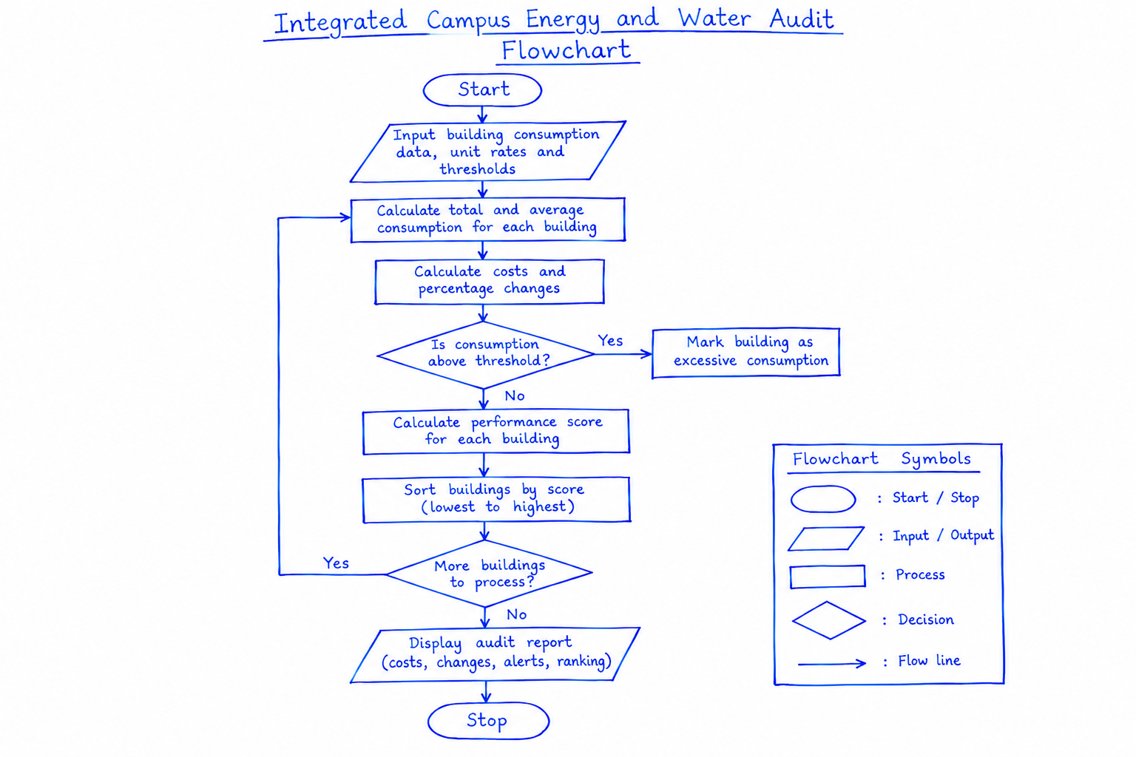
Flow chart

Slide 87
Python source code
# Integrated Campus Energy and Water Audit
buildings = {
"Academic Block": {
"electricity": [120, 135, 150],
"water": [18, 20, 24]
},
"Library": {
"electricity": [80, 78, 90],
"water": [12, 11, 13]
},
"Hostel": {
"electricity": [200, 220, 250],
"water": [35, 40, 45]
}
}
# Rates and daily consumption thresholds
electricity_rate = 8
water_rate = 30
electricity_limit = 140
water_limit = 25
results = []
for name, data in buildings.items():
electricity = data["electricity"]
water = data["water"]
total_e = sum(electricity)
total_w = sum(water)
avg_e = total_e / len(electricity)
avg_w = total_w / len(water)
cost_e = total_e * electricity_rate
cost_w = total_w * water_rate
total_cost = cost_e + cost_w
print("\n---", name, "---")
print("Total electricity:", total_e, "kWh")
print("Total water:", total_w, "kL")
print("Average electricity:", round(avg_e, 2))
print("Average water:", round(avg_w, 2))
print("Electricity cost: Rs.", cost_e)
print("Water cost: Rs.", cost_w)
print("Total cost: Rs.", total_cost)
# Calculate daily percentage changes
for label, readings in [
("Electricity", electricity),
("Water", water)
]:
print(label, "percentage changes:")
for i in range(1, len(readings)):
previous = readings[i - 1]
current = readings[i]
if previous == 0:
print("Day", i, "to", i + 1,
": Undefined")
else:
change = (
(current - previous) / previous
) * 100
print(
"Day", i, "to", i + 1,
":", round(change, 2), "%"
)
# Identify excessive consumption
alerts = []
if avg_e > electricity_limit:
alerts.append("Excessive electricity")
if avg_w > water_limit:
alerts.append("Excessive water")
if not alerts:
alerts.append("Within thresholds")
# Calculate weighted performance score
score = (
50 * avg_e / electricity_limit
+ 50 * avg_w / water_limit
)
results.append({
"name": name,
"cost": total_cost,
"score": score,
"alerts": alerts
})
# Rank buildings by score
results.sort(key=lambda item: item["score"])
print("\n===== CAMPUS AUDIT SUMMARY =====")
print("Rank | Building | Total Cost | Score | Status")
for rank, item in enumerate(results, start=1):
print(
rank, "|",
item["name"], "|",
"Rs.", round(item["cost"], 2), "|",
round(item["score"], 2), "|",
", ".join(item["alerts"])
)
print("\nAudit completed.")

Slide 88
Test cases
Test case | Input condition | Expected result
1 | Consumption is below both thresholds | Building is marked within thresholds
2 | Electricity exceeds its threshold | Electricity alert is generated
3 | Water exceeds its threshold | Water alert is generated
4 | Consumption increases between days | Positive percentage change is calculated
5 | Consumption decreases between days | Negative percentage change is calculated
6 | Previous day's consumption is zero | Percentage change is reported as undefined
7 | Multiple buildings have different scores | Buildings are ranked from lowest to highest score

Slide 89
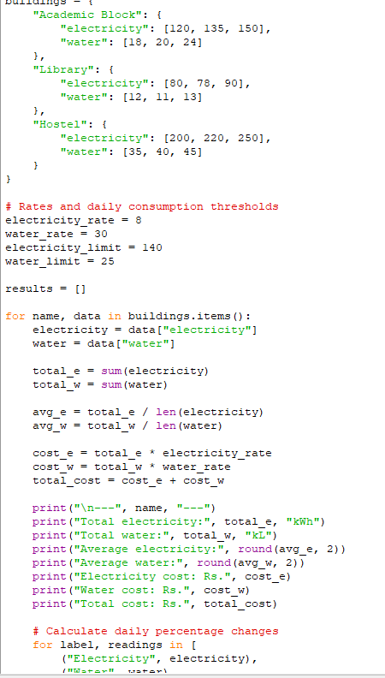
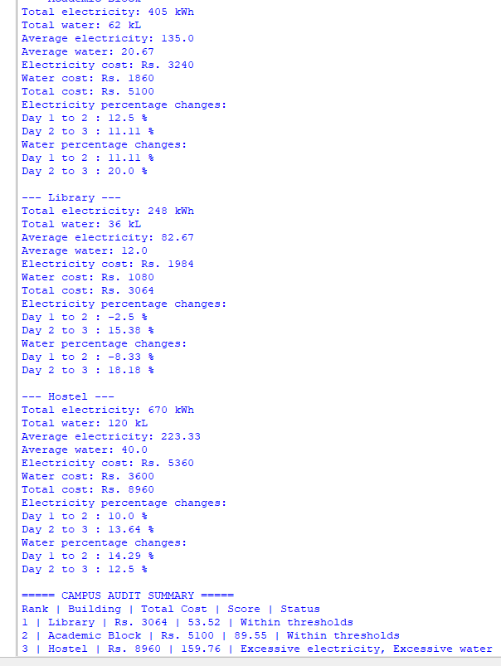
Screenshot of code and output
CODE
OUTPUT

Slide 90
Conclusion
The Integrated Campus Energy and Water Audit project demonstrates how Python can analyse electricity and water consumption across multiple campus buildings and days. The program calculates total and average consumption, estimates operating costs, determines percentage changes, and identifies excessive resource usage.
By applying a weighted scoring method, the program ranks buildings according to their consumption relative to defined thresholds. This analysis helps campus administrators identify buildings that may need conservation measures, improve resource management, and reduce operating expenses.
The project demonstrates the practical application of lists, dictionaries, loops, conditional statements, arithmetic operations, and sorting in Python.

